Slide 1
Recurrent Neural Networks

Slide 2
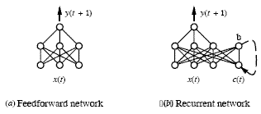
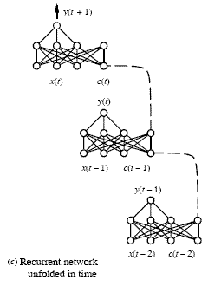
Recurrent Neural Networks
Use the outputs of network units at time t as the input to other units at time t+1

Slide 3
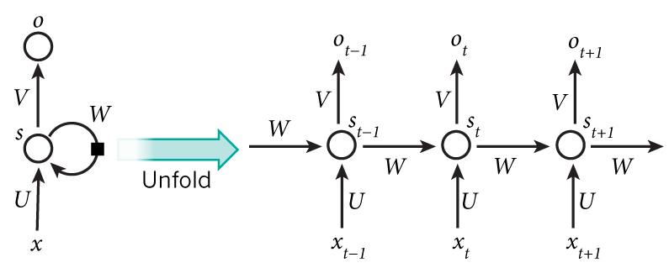
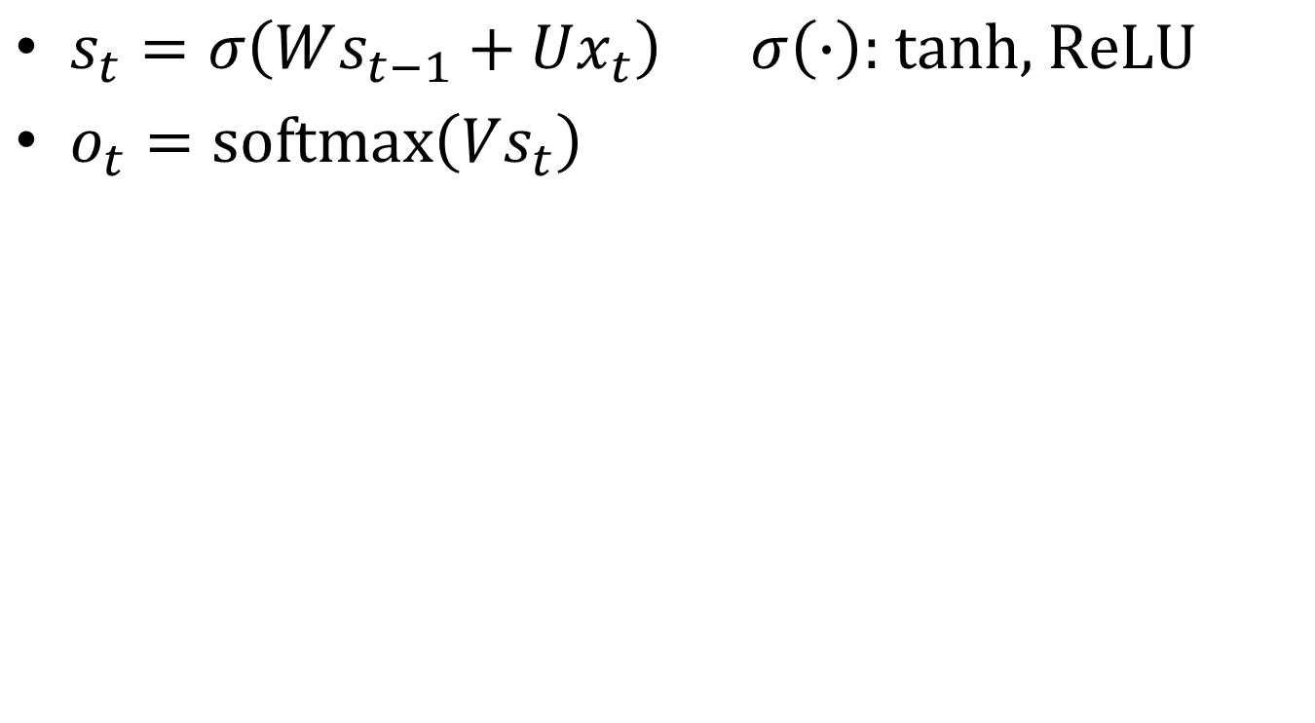
Recurrent Neural Networks
.
$s_{t}=σ\left(Ws_{t−1}+Ux_{t}\right)$ $σ\left(∙\right)\text{: }\text{tanh}\text{, }\text{ReL}U$
$o_{t}=\text{softmax}\left(Vs_{t}\right)$

Slide 4

RNN Example Application
Slot Filling
  I would like to arrive Taipei on November 2nd.
ticket booking system
Destination:
Taipei
Slot
time of arrival:
November 2nd
Notes:
https://catalog.ldc.upenn.edu/docs/LDC93S4B/corpus.html

Slide 5
RNN
The same network is used again and again.
Probability of “arrive” in each slot
Probability of “Taipei” in each slot
Probability of “on” in each slot
y¹
y²
y³
store
store
a¹
a²
a³
a¹
a²
x¹
x²
x³
  arrive Taipei on November 2nd
Notes:
General idea

Slide 6
Of course it can be deep …
y^{t}
y^{t+1}
y^{t+2}
……
……
……
……
……
……
……
……
……
x^{t}
x^{t+1}
x^{t+2}

Slide 7
Long Short-term Memory (LSTM)
Other part of the network
Special Neuron:
4 inputs,
1 output
Signal control the output gate
Output Gate
(Other part of the network)
Memory
Cell
Forget Gate
Signal control the forget gate
(Other part of the network)
Signal control the input gate
Input Gate
LSTM
(Other part of the network)
Other part of the network
Notes:
Normal neuron
1 input, 1 output
This one
4 input, 1 output

Slide 8
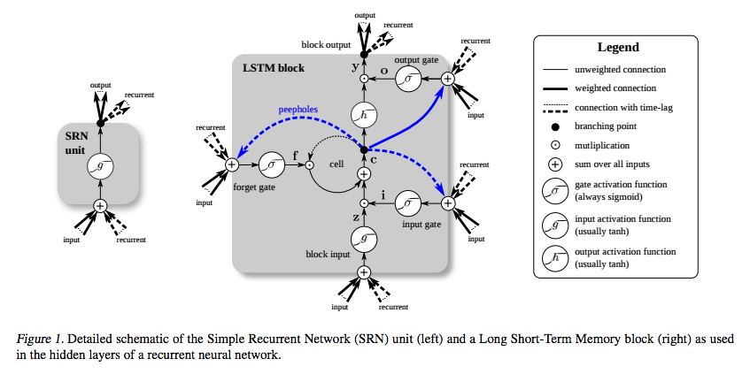

Slide 9
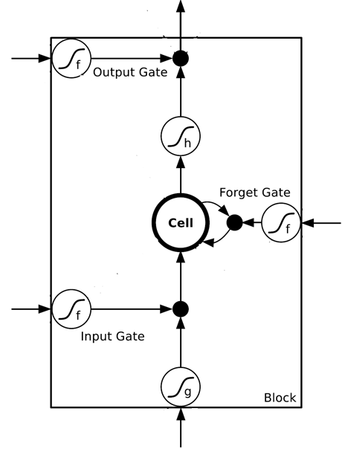
















$$a$$
$$=h\left(c^{′}\right)f\left(z_{o}\right)$$
$$z_{o}$$
multiply
Activation function f is usually a sigmoid function
$$f\left(z_{o}\right)$$
$$h\left(c^{′}\right)$$
Between 0 and 1
Mimic open and close gate
$$c$$
$$f\left(z_{f}\right)$$
c
$$c^{′}$$
$$z_{f}$$
$$cf\left(z_{f}\right)$$
$$c^{′}=g\left(z\right)f\left(z_{i}\right)+cf\left(z_{f}\right)$$
$$f\left(z_{i}\right)$$
$$g\left(z\right)f\left(z_{i}\right)$$
$$z_{i}$$
multiply
$$g\left(z\right)$$
$$z$$

Slide 10
LSTM
c^{t-1}
……
vector
z^{f}
z^{i}
z
zº
4 vectors
x^{t}
Notes:
Identiy
C is vector

Slide 11

LSTM
y^{t}
zº
c^{t-1}
$$×$$
$$＋$$
$$×$$
z^{f}
$$×$$
z^{i}
z^{f}
z^{i}
z
zº
x^{t}
z
Notes:
Identiy
C is vector

Slide 12
LSTM
Extension: “peephole”
y^{t}
y^{t+1}
c^{t-1}
c^{t}
c^{t+1}
$$×$$
$$＋$$
$$×$$
$$×$$
$$＋$$
$$×$$
$$×$$
$$×$$
z^{f}
z^{i}
z
zº
z^{f}
z^{i}
z
zº
c^{t-1}
h^{t-1}
x^{t}
c^{t}
h^{t}
x^{t+1}
Notes:
Identiy
C is vector

Slide 13
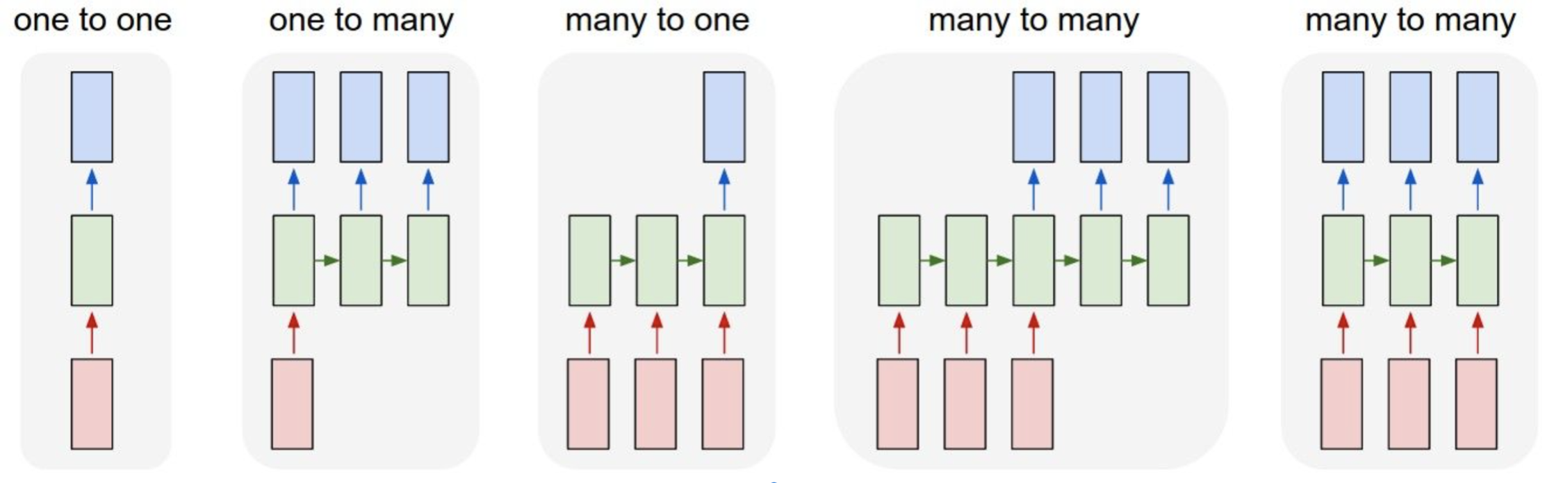
five variations of RNNs
  one to many: image -> caption sentence
  many to one: sentence -> sentiment (positive / negative label)
  many to many: a sentence in English -> a sentence in Turkish
  the other many to many: frames of video -> coordinates of bounding boxes around an object
https://towardsdatascience.com/introduction-to-rnns-sequence-to-sequence-language-translation-and-attention-fc43ef2cc3fd

Slide 14
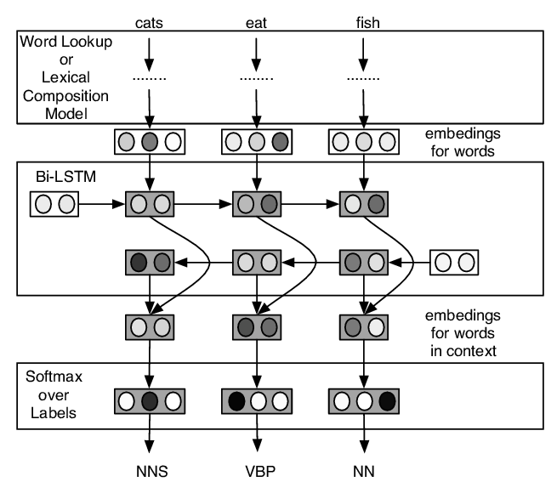
Neural network for POS tagging
https://www.researchgate.net/publication/280912217_Finding_Function_in_Form_Compositional_Character_Models_for_Open_Vocabulary_Word_Representation

Slide 15
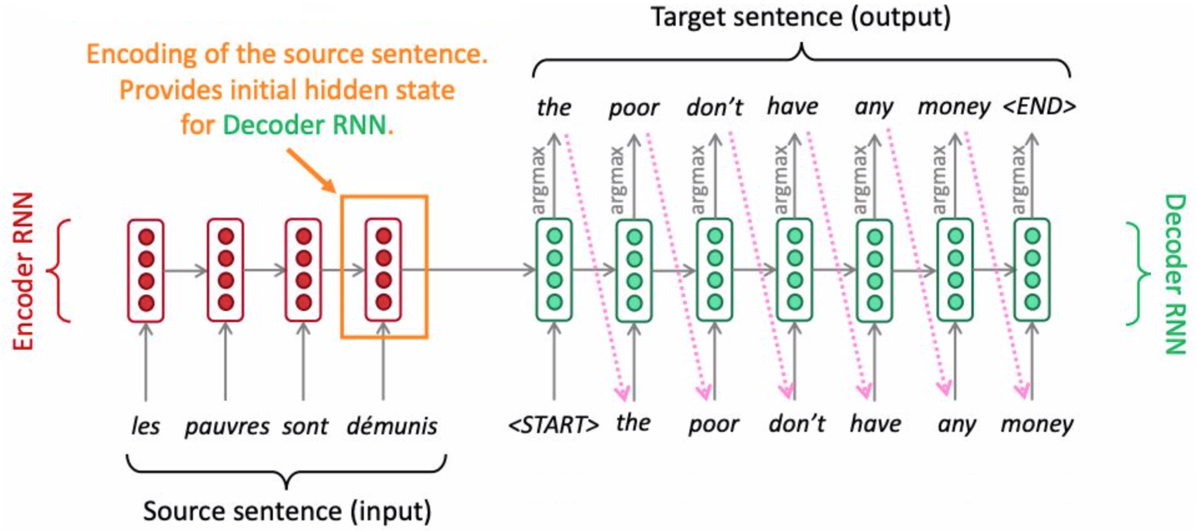
Sequence to Sequence

Slide 16
Jena Climate Dataset
Recorded every 10 minutes
14 different quantities
From January 1st 2009 to December 31st 2016
https://www.kaggle.com/datasets/mnassrib/jena-climate

Slide 17
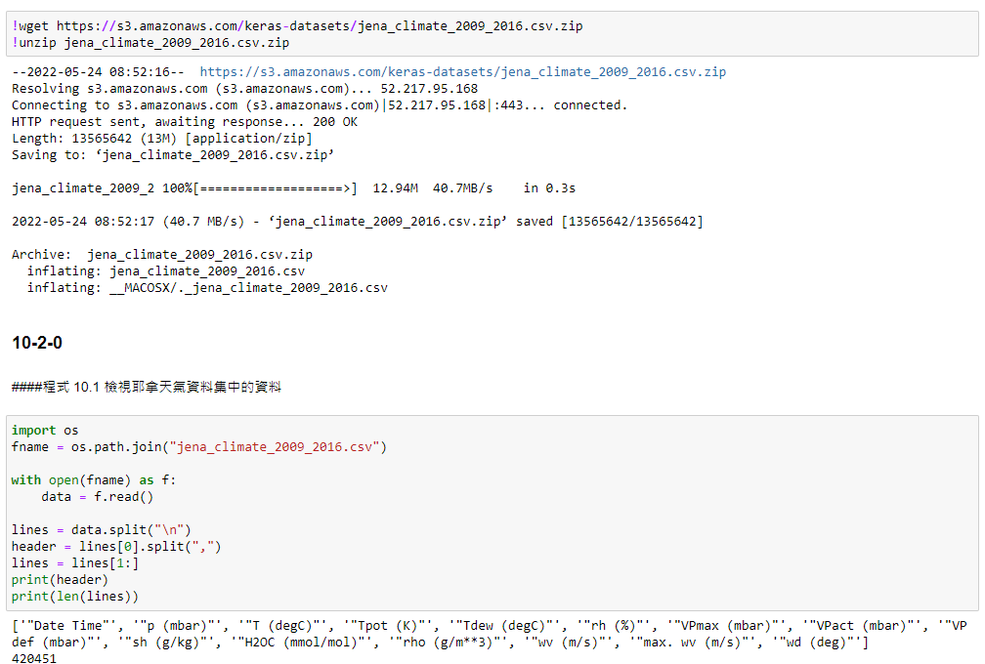

Slide 18
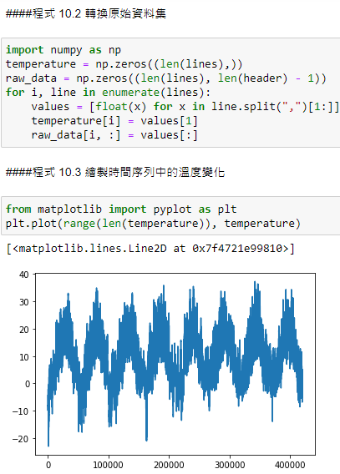
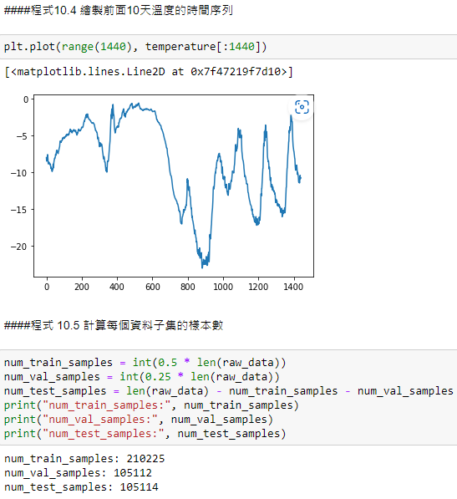

Slide 19
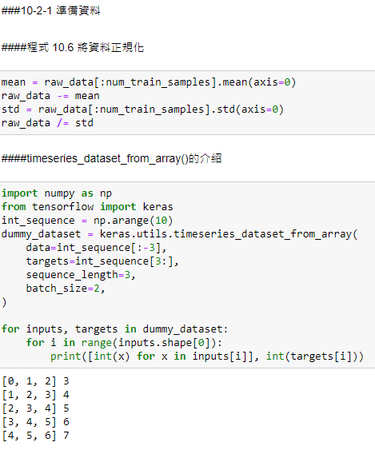
Given 5 days weather data, predict the temperature after 24 hours
timeseries_dataset_from_array()
Creates a dataset of sliding windows over a timeseries provided as array.
This function takes in a sequence of data-points gathered at equal intervals, along with time series parameters such as length of the sequences/windows, spacing between two sequence/windows, etc., to produce batches of timeseries inputs and targets.
Arguments
data: Numpy array or eager tensor containing consecutive data points (timesteps). Axis 0 is expected to be the time dimension.
targets: Targets corresponding to timesteps in data. targets[i] should be the target corresponding to the window that starts at index i (see example 2 below). Pass None if you don't have target data (in this case the dataset will only yield the input data).
sequence_length: Length of the output sequences (in number of timesteps).
sequence_stride: Period between successive output sequences. For stride s, output samples would start at index data[i], data[i + s], data[i + 2 * s], etc.
sampling_rate: Period between successive individual timesteps within sequences. For rate r, timesteps data[i], data[i + r], ... data[i + sequence_length] are used for create a sample sequence.
batch_size: Number of timeseries samples in each batch (except maybe the last one).
shuffle: Whether to shuffle output samples, or instead draw them in chronological order.
seed: Optional int; random seed for shuffling.
start_index: Optional int; data points earlier (exclusive) than start_index will not be used in the output sequences. This is useful to reserve part of the data for test or validation.
end_index: Optional int; data points later (exclusive) than end_index will not be used in the output sequences. This is useful to reserve part of the data for test or validation.
Returns
A tf.data.Dataset instance. If targets was passed, the dataset yields tuple (batch_of_sequences, batch_of_targets). If not, the dataset yields only batch_of_sequences.

Slide 20
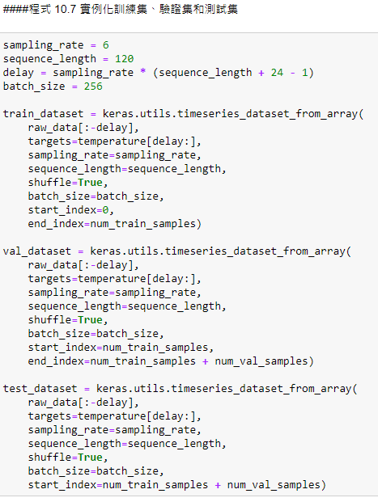
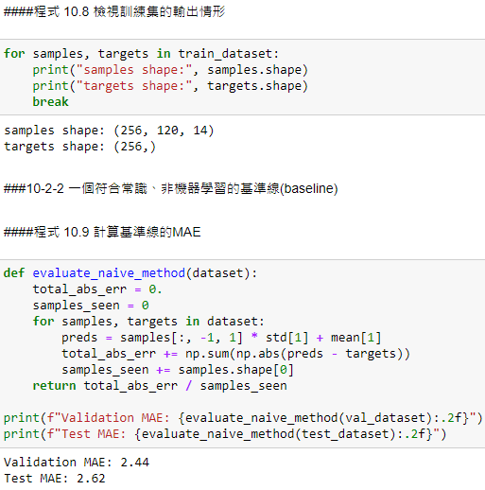

Slide 21
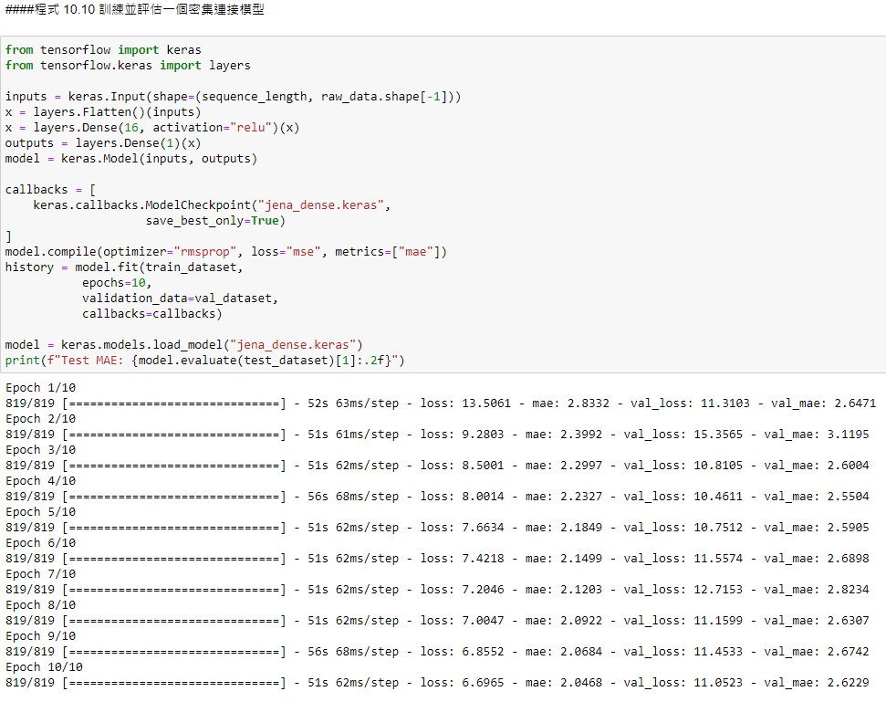

Slide 22
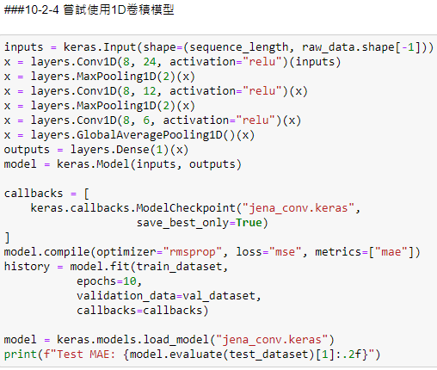

Slide 23
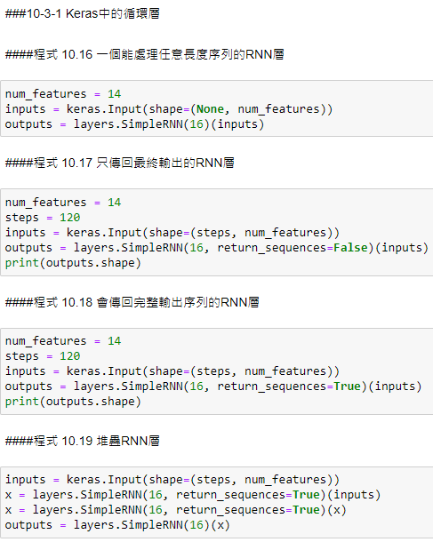

Slide 24
keras.layers.SimpleRNN(units, activation='tanh', use_bias=True, kernel_initializer='glorot_uniform', recurrent_initializer='orthogonal', bias_initializer='zeros', kernel_regularizer=None, recurrent_regularizer=None, bias_regularizer=None, activity_regularizer=None, kernel_constraint=None, recurrent_constraint=None, bias_constraint=None, dropout=0.0, recurrent_dropout=0.0, return_sequences=False, return_state=False, go_backwards=False, stateful=False, unroll=False)
Fully-connected RNN where the output is to be fed back to input.
  units: Positive integer, dimensionality of the output space.
  activation: Activation function to use. Default: hyperbolic tangent (tanh). If you pass None, no activation is applied (ie. "linear" activation: a(x) = x).
  use_bias: Boolean, whether the layer uses a bias vector.
  dropout: Float between 0 and 1. Fraction of the units to drop for the linear transformation of the inputs.
  recurrent_dropout: Float between 0 and 1. Fraction of the units to drop for the linear transformation of the recurrent state.
  return_sequences: Boolean. Whether to return the last output in the output sequence, or the full sequence.
  return_state: Boolean. Whether to return the last state in addition to the output.
  go_backwards: Boolean (default False). If True, process the input sequence backwards and return the reversed sequence.
  stateful: Boolean (default False). If True, the last state for each sample at index i in a batch will be used as initial state for the sample of index i in the following batch.
  unroll: Boolean (default False). If True, the network will be unrolled, else a symbolic loop will be used. Unrolling can speed-up a RNN, although it tends to be more memory-intensive. Unrolling is only suitable for short sequences.

Slide 25
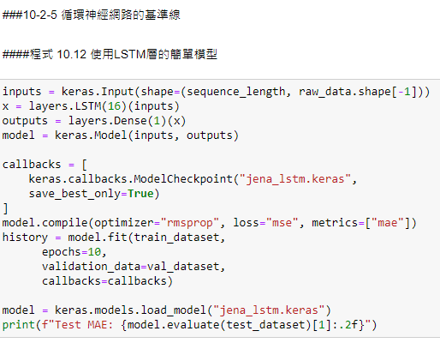
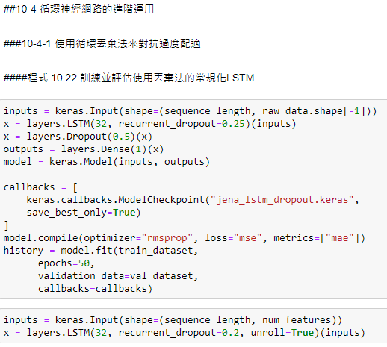

Slide 26
keras.layers.LSTM(units, activation='tanh', recurrent_activation='sigmoid', use_bias=True, kernel_initializer='glorot_uniform', recurrent_initializer='orthogonal', bias_initializer='zeros', unit_forget_bias=True, kernel_regularizer=None, recurrent_regularizer=None, bias_regularizer=None, activity_regularizer=None, kernel_constraint=None, recurrent_constraint=None, bias_constraint=None, dropout=0.0, recurrent_dropout=0.0, implementation=2, return_sequences=False, return_state=False, go_backwards=False, stateful=False, unroll=False)
Long Short-Term Memory layer - Hochreiter 1997.
  recurrent_activation: Activation function to use for the recurrent step. Default: hard sigmoid (hard_sigmoid). If you pass None, no activation is applied (ie. "linear" activation: a(x) = x).
  unit_forget_bias: Boolean. If True, add 1 to the bias of the forget gate at initialization. Setting it to true will also force bias_initializer="zeros". This is recommended in Jozefowicz et al. (2015).
  implementation: Implementation mode, either 1 or 2. Mode 1 will structure its operations as a larger number of smaller dot products and additions, whereas mode 2 will batch them into fewer, larger operations. These modes will have different performance profiles on different hardware and for different applications.

Slide 27
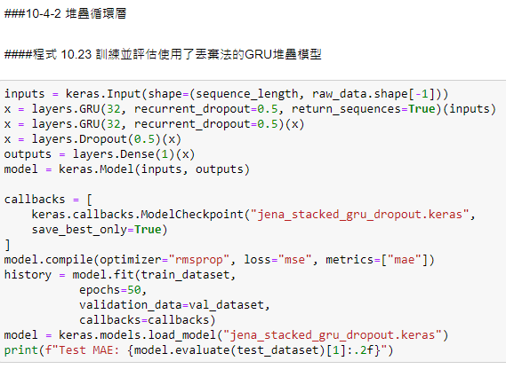

Slide 28
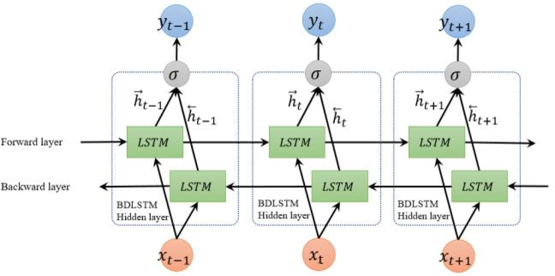
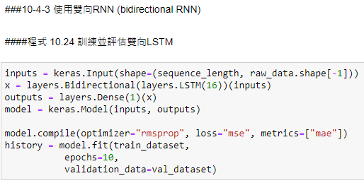
Bidirectional LSTM (biLSTM)
layer: Recurrent instance.
merge_mode: Mode by which outputs of the forward and backward RNNs will be combined. One of {'sum', 'mul', 'concat', 'ave', None}. If None, the outputs will not be combined, they will be returned as a list.
weights: Initial weights to load in the Bidirectional model

